Slide 1

Store Sales Dataset Analysis
Our Team

Slide 2







Our Team
Mahmoud Gamal
Ebraam Gerges
Renad Ragab
Team Leader
Eslam Mohamed
Aya Alaa
Omnia Abdelraheem

Slide 3
1. Introduction and The Goal
2. About the dataset
3. Cleaning and Preprocessing
Agenda
4. Data Modeling
5. Questions Analysis
6. Visualization Dashboards
7. Conclusion
8. Recommendations
Our Team

Slide 4
Introduction
The project
1. analyzes store sales data for IKEA.
2. focusing on key metrics to understand customer behavior. 3. product performance, and order patterns.
It examines:
1. customer demographics. 2. sales transactions. 3. product categories. 4. order details to identify factors influencing sales performance.

Slide 5
The goal
The project aims:
1. provide actionable insights to optimize sales strategies
2. improve customer satisfaction
3. enhance overall business performance.

Slide 6
About The Data Dataset

Slide 7
Dataset Overview
This dataset contains information about global road accidents from 2015 to 2018.
The aim of this analysis is to analyze sales analysis and customer behavior insights.
This dataset contains 9800 rows and 18 columns .
This dataset contains quantitative and qualitative data types.

Slide 8
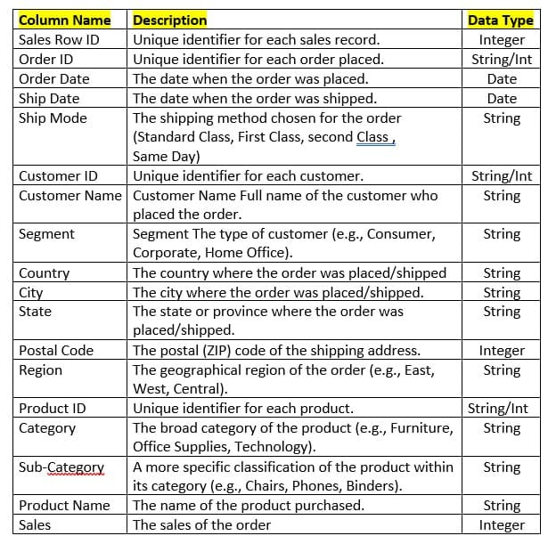
Data Fields Description

Slide 9
Cleaning and Preprocessing
Data Cleaning: Ensuring the initial data is organized and clean.
Missing Value Handling: Addressing the missing entries in the postal code column.
Date Splitting: Separating the order and ship dates into individual components.
New Feature Generation: Creating new attributes like the ship quarter and shipping duration.
No Column Removal: Retaining all original columns in the dataset.

Slide 10
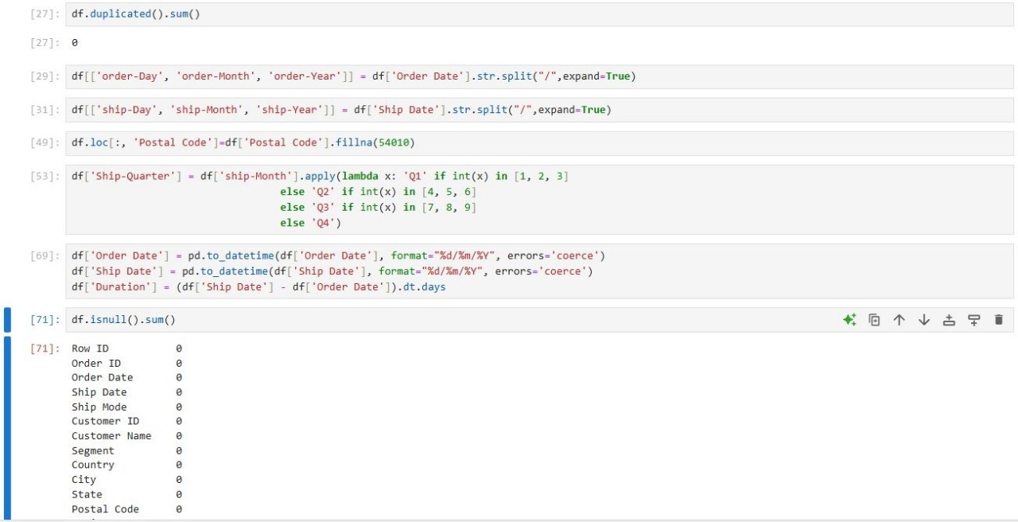
Cleaning and Preprocessing
Our data is found in clean form.
Our dataset looks a bit tidy with no duplicated values .
"Postal Code" column has 11 null values that need to be handled , so we replaced them by suitable postal code for the mentioned state.
We separated "Order Date" column into three columns : "order-Day" , "order-Month" , "order-Year".
We separated "Ship Date" column into three columns : "ship-Day" , "ship-Month" , "ship-Year".
We added "Ship-Quarter" column depending on "ship-Month" that we created before.

Slide 11
Data Modeling
Our data is found in clean form.
Our dataset looks a bit tidy with no duplicated values .
"Postal Code" column has 11 null values that need to be handled , so we replaced them by suitable postal code for the mentioned state.
We separated "Order Date" column into three columns : "order-Day" , "order-Month" , "order-Year".
We separated "Ship Date" column into three columns : "ship-Day" , "ship-Month" , "ship-Year".
We added "Ship-Quarter" column depending on "ship-Month" that we created before.

Slide 12
Data Modeling
We started by exploring and studying the dataset thoroughly to understand its structure and contents.
We divided the data into four separate sheets based on logical categories:
Contained all customer-related information.
Orders Sheet: Included order details and transactions.
Products Sheet: Focused on product information and classifications.
Shipping Sheet: Covered shipping details and logistics.
We established relationships between the sheets to ensure proper data integration and referential integrity.
We designed an Entity-Relationship Diagram (ERD) using 'Figma' Website to visually represent the data structure and connections.
The entire modeling and transformation process was implemented using SQL.
Our data is found in clean form.
Our dataset looks a bit tidy with no duplicated values .
"Postal Code" column has 11 null values that need to be handled , so we replaced them by suitable postal code for the mentioned state.
We separated "Order Date" column into three columns : "order-Day" , "order-Month" , "order-Year".
We separated "Ship Date" column into three columns : "ship-Day" , "ship-Month" , "ship-Year".
We added "Ship-Quarter" column depending on "ship-Month" that we created before.

Slide 13
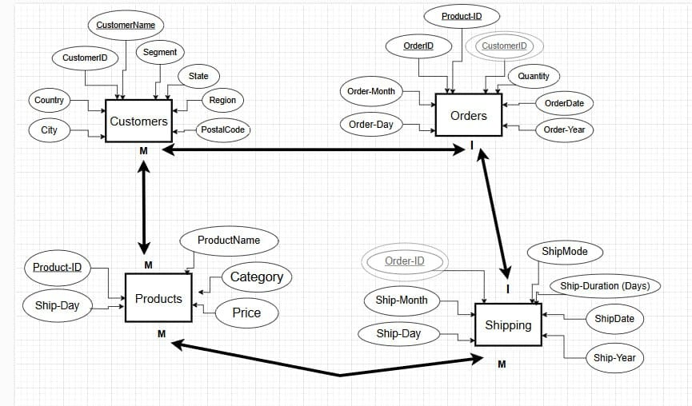
Data Modeling
Our data is found in clean form.
Our dataset looks a bit tidy with no duplicated values .
"Postal Code" column has 11 null values that need to be handled , so we replaced them by suitable postal code for the mentioned state.
We separated "Order Date" column into three columns : "order-Day" , "order-Month" , "order-Year".
We separated "Ship Date" column into three columns : "ship-Day" , "ship-Month" , "ship-Year".
We added "Ship-Quarter" column depending on "ship-Month" that we created before.

Slide 14
Visualization Dashboards

Slide 15
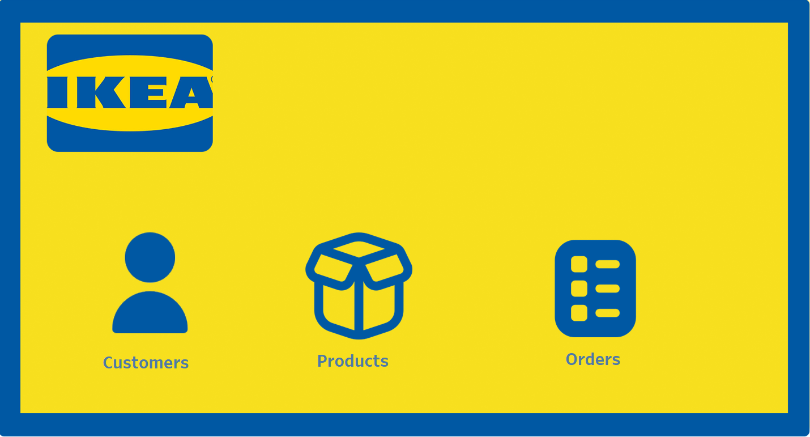
Visualization Dashboards

Slide 16
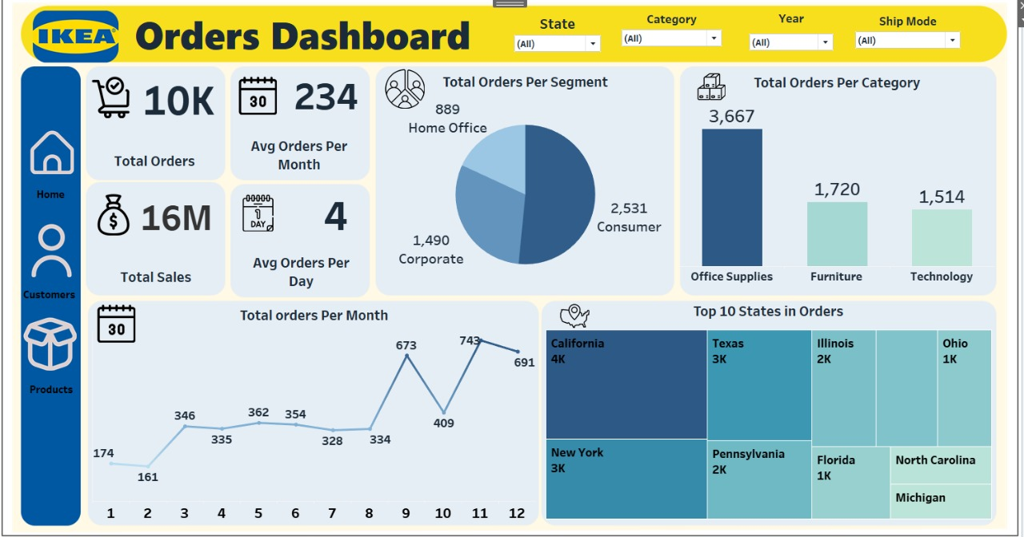
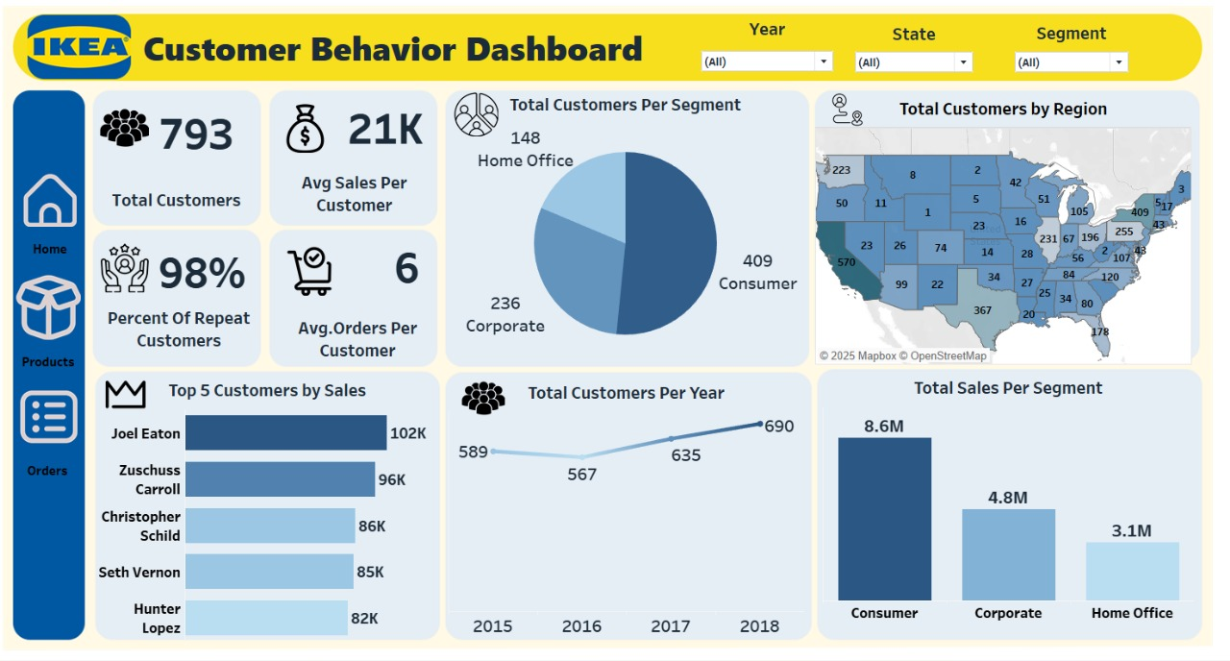
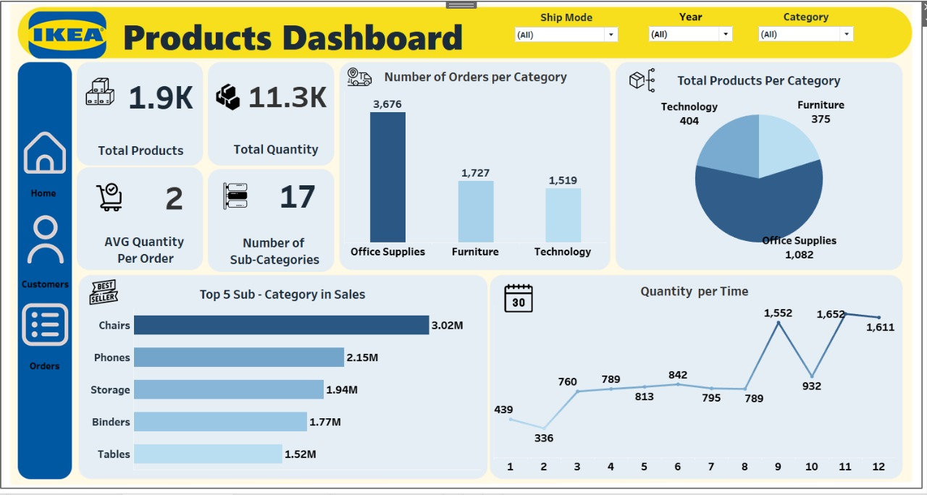
Visualization Dashboards

Slide 17
Visualization Dashboards

Slide 18
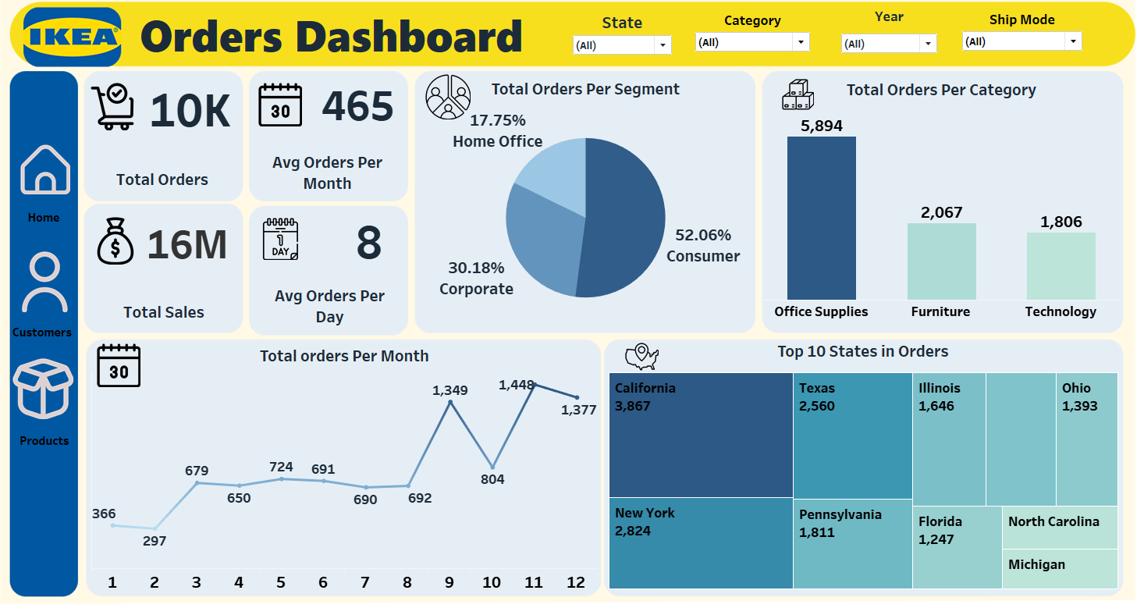
Visualization Dashboards

Slide 19
Conclusion

Slide 20
Conclusion
The IKEA dashboards provide a comprehensive overview of:
the company's sales performance
customer behavior
product effectiveness
Consumer segment Analysis of the key performance indicators (KPIs) reveals several important insights:
1- Customer Behavior
3- Order Analysis
2- Product Performance

Slide 21
Conclusion
Consumer segment Analysis of the key performance indicators (KPIs) reveals several important insights:
The IKEA dashboards provide a comprehensive overview of:
the company's sales performance
1- Customer Behavior
customer behavior
product effectiveness
The company has a strong customer base, with a high percentage of repeat customers (98%).
Most customers are in the Consumer segment.
Average sales per customer is $21K.
Top 5 Customers by Sales are Joel Eaton, Zuschuss Carroll, Christopher Schild, Seth Vernon, and Hunter Lopez .
3- Order Analysis:
2- Product Performance:

Slide 22
Conclusion
Consumer segment Analysis of the key performance indicators (KPIs) reveals several important insights:
The IKEA dashboards provide a comprehensive overview of:
the company's sales performance
2- Product Performance
customer behavior
product effectiveness
Office Supplies is the top-selling category.
Chairs are the top-selling subcategory.
3- Order Analysis:

Slide 23
Conclusion
Consumer segment Analysis of the key performance indicators (KPIs) reveals several important insights:
The IKEA dashboards provide a comprehensive overview of:
the company's sales performance
3- Order Analysis
customer behavior
product effectiveness
Total sales are $16M .
Most orders come from the Consumer segment.
Average orders per month are 234, with 4 orders per day.
California is the state with the highest number of orders.

Slide 24
Recommendations

Slide 25
Recommendations
Boost Loyalty: Implement targeted loyalty programs to reward repeat customers (98% rate).
Segment Marketing: Tailor marketing to customer groups (Consumer, Corporate, Home Office).
Segment Marketing: Tailor marketing to customer groups (Consumer, Corporate, Home Office).
Maximize Top Category: Focus on the strong Office Supplies category to drive sales.
Promote Best Sellers: Increase marketing for top-selling sub-categories like Chairs.
Analyze Order Trends: Adjust inventory based on monthly order fluctuations.
Optimize Regional Strategy: Tailor sales and distribution based on top-performing states.

Slide 26



